Slide 1
Forecasting Crime Incidents in Boston
using Time Series Modeling
By: Parag Sasturkar
Presented on: 12/13/2018
ABSTRACT
Crime is an unfortunate issue that societies need to deal with. Therefore, I believe that understanding it, and predicting the future incidents based on past, and then preparing for it is of utmost importance for societies to self-govern. “Prevention is always better than cure,” says Romanian doctors and this goes hand in hand with my objective of forecasting number of crime incidents in Boston. This paper looks to build a time series model for analyzing crime data in Boston from July 2015 – September 2018. After model building, validation, and testing in practice, I chose the ARIMA(0,1,0)(0,1,0)[12] model as the champion model for forecasting purpose. Having said that some of the limitations of this paper and also recommendations for future analysis are also included.

Slide 2
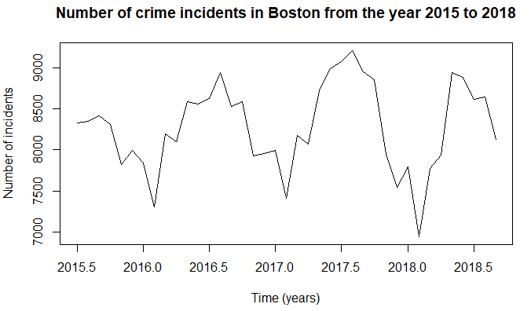
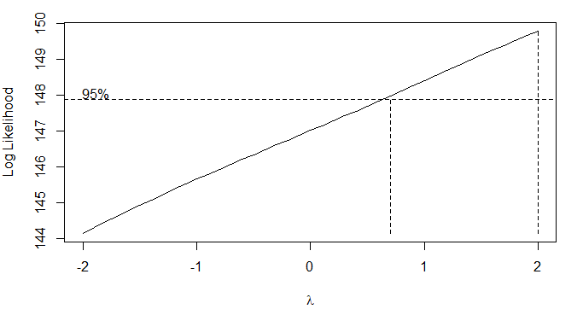

DATA INFORMATION
Collected from July 2015 – September 2018 (https://www.kaggle.com/ankkur13/boston-crime-data)
Goal: Forecast crime incidents in Boston
Transformation Needs: Seasonal and Normal Differencing
Box Cox Transformation

Slide 3
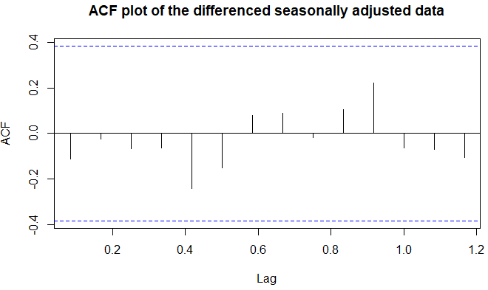
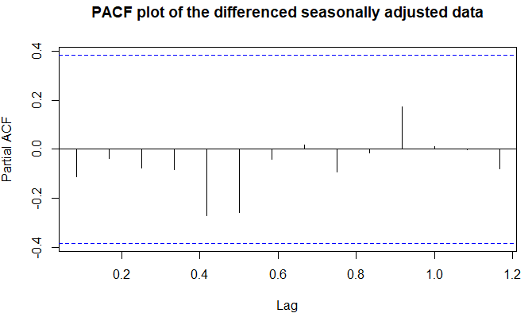
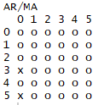
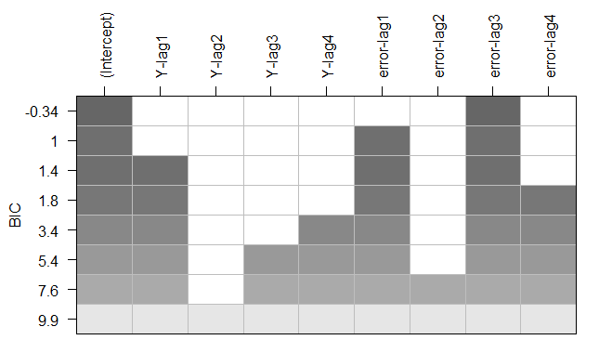
MODEL SELECTION
EACF plot of the differenced seasonally adjusted data
BIC plot of the differenced seasonally adjusted data

Slide 4
METHODS
Multiple models were built and ARIMA(0,1,0)(0,1,0)[12] model was selected as the champion model
Model Equation: ∇∇₁₂(Y_{t}) = e_{t}
(where e_{t} is a white noise zero mean process with constant variance as 58745)
Model Assumptions:
E[e_{t}] = 0
Var[e_{t}] = σ² (constant)
Cov(e_{t}, e_{t-k}) = 0 (White Noise)
e_{t,s} are normally distributed

Slide 5
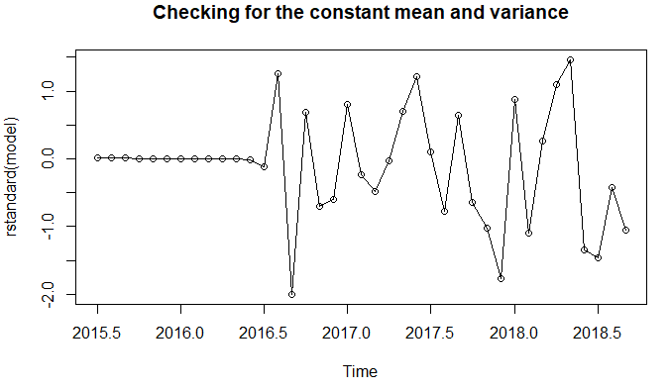
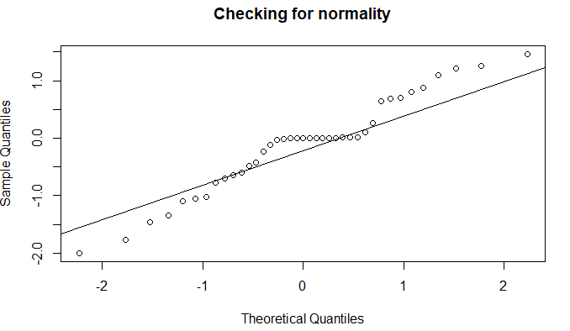
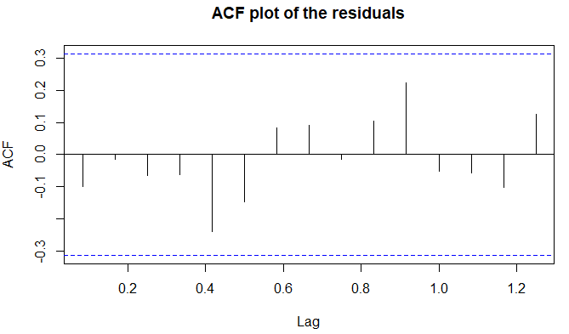

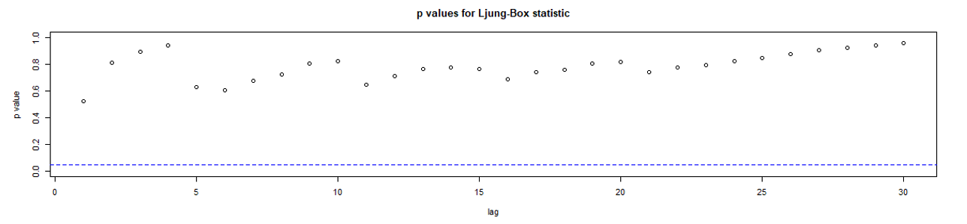
MODEL ASSUMPTIONS

Slide 6
ANALYSIS OF OVERPARAMETERIZED MODELS
Model | Parameters Significance | Change in Estimates | AIC | Parsimony | Result
ARIMA(0,1,0)(0,1,0)[12] | Zero parameters | No change | 361.29 | Supports this model | Champion model (Putative model)
ARIMA(1,1,0)(0,1,0)[12] | MA parameter was not significant as its confidence interval (-0.480884, 0.3204021) contained zero in it | Very similar | 363.14 | Does not Support this model over the first model | Overparameterized model

Slide 7
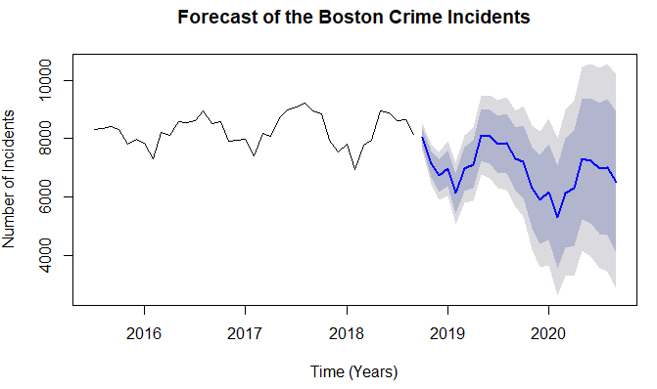

APPLICATION – FORECASTING CRIME INCIDENTS
Forecast Boston Crime Incidents in the near future – From the forecast, it shows that overall incidents are going down with seasonal pattern
Accurate forecasting is beneficial for society because law enforcement can use this data prediction to prepare for forecasted crime incidents

Slide 8
CONCLUSION
Police departments across the world have to deal with the reality that crime is prevalent. The data was collected in order to predict the future crime incidents in Boston that were to occur over the next two years. The ARIMA(0,1,0)(0,1,0)[12] model was ultimately selected as the model to forecast with, and the model was proven to forecast with accuracy and reliability.
LIMITATIONS AND FUTURE SCOPE
As you know there might be n number of factors that are basically responsible for the increase or decrease in the crime incidents. In my opinion, the limitations of this model are that it does not consider any external factors such as for example political impact or say poverty rate or any such factors into consideration while forecasting the crime incidents.
The future work may include determining if incorporating external factors increases or decreases the forecasting abilities of this particular data set. Basically, the current forecasted numbers looked convincing based on the past and hence I could say that my model was working properly. But here a point should be noted that this forecast might change if you include external factors in the analysis. This would be a very good future scope to carry forward with this idea of forecasting crime incidents in the Boston region.

